Slide 1

Legal Framework Governing Real Estate in Kenya
By Lucy Thuo

Slide 2

Introduction
The Constitution of Kenya, 2010 guarantees the right to property (real estate) under Article 40. This fundamental right is envisaged in the constitution as follows: every person has the right either individually or in association with others to acquire and own property of any description and in any part of Kenya.

Slide 3
Legal Framework Governing Home Ownership in Kenya

Slide 4
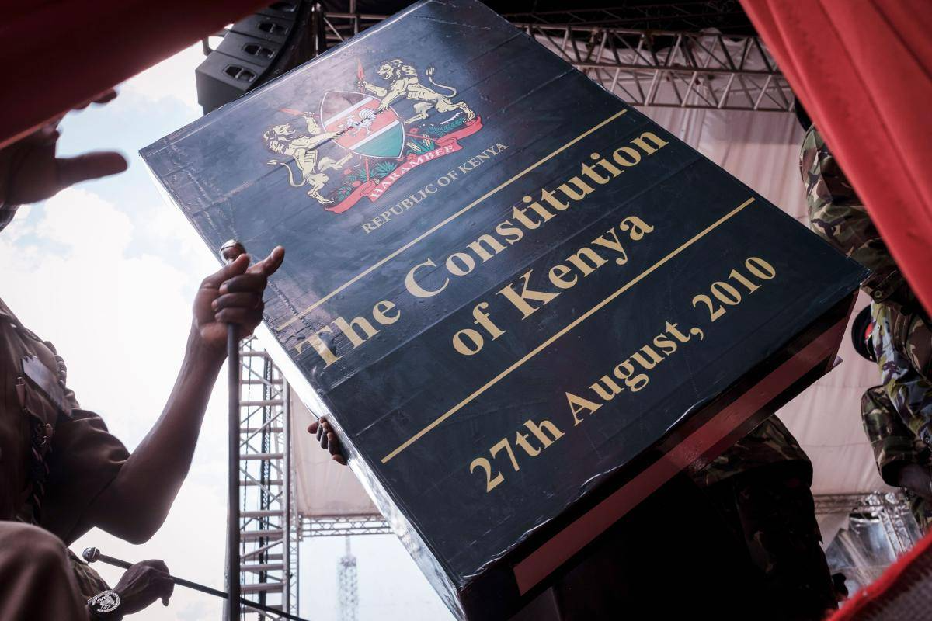
The Constitution of Kenya,2010
This being the supreme law of the land, it provides for the legal framework in land transaction and land ownership. The Constitution has dedicated the entire chapter 5 on Land and Environment. This chapter provides for the classification and categories of land to wit public land, community land and private land. Under the category of private land, it can either be leasehold or freehold in terms of tenure.
It is also important to note that under article 65 the Constitution guarantee non-citizens the right to property and it states that “a person who is not a citizen may hold land on the basis of leasehold tenure only and any such lease, however granted, shall not exceed ninety-nine years.
The applicable statutes in land include:

Slide 5
LAND ACT NO. 6 OF 2012
LAND REGISTRATION ACT, 2012
COMMUNITY LAND ACT, 2016
This Act together with the regulations consolidates all the different land systems in Kenya and provides for sustainable administration and management of land and land-based resources.
This act provides for the recognition, protection and registration of community land rights as well as management and administration of community land.
This Act governs the registration of interests in all public, private and community land in Kenya
NATIONAL LAND COMMISSION ACT, 2012
SECTIONAL PROPERTIES ACT, NO. 21 OF 2020
PHYSICAL AND LAND USE PLANNING ACT NO. 13, 2019
This act establishes the National Land Commission and tasks it with the responsibilities of managing public land
This Act provides for the division of buildings into units, ownership of common property of buildings and for the use and management of units and common property.
This Act provides the framework on matters relating to land use development planning, development control, enforcement and dispute resolution.

Slide 6
ENVIRONMENTAL MANAGEMENT AND COORDINATION ACT, 1999
ENVIRONMENT AND LAND COURT ACT,2011
LAND CONTROL ACT CAP 302
This Act establishes the Land Control Board for every land control area and task it with the responsibility of overseeing and issuing consent in transactions touching on agricultural land.
This Act establishes the Environment and Land Court (ELC) for purposes of facilitating the just, expeditious, proportionate and accessible resolution of disputes relating to land ownership and title.
This Act deals with environmental issues and establishes the National Environment Management Authority (NEMA).
STAMP DUTY ACT (CAP 480)
INCOME TAX ACT (CAP 470)
THE VALUE ADDED TAX, 2013
The Act provides for the levying and managing of stamp duties.
This Act provides the legal framework for levying and computation of capital gains tax on transfer of property.
The Act provides for the legal framework for levying of value added tax on the sale, leasing, renting of commercial properties.

Slide 7
Real Estate Professionals

Slide 8

Real Estate Development Regulatory Framework in Kenya
Real Estate development is a highly specialized process, therefore, it is crucial to establish a comprehensive regulatory framework that helps to regulate the activities of professionals involved as well as ensure that they comply with the laws and regulations governing their profession, thus providing high-quality services. Moreover, Real Estate development is subject to land use regulations which are dictated by zoning regulations, environmental considerations, or community planning efforts. Accordingly, the legal and regulatory framework that governs Real Estate development activities in Kenya and built industry professionals is multifaceted.
The following section highlights the relevant laws and regulations pertaining to Real Estate development in Kenya;

Slide 9
NATIONAL CONSTRUCTION AUTHORITY (NCA) ACT, CAP 486
ENGINEER’S ACT NO. 43 OF 2011
ARCHITECTS AND QUANTITY SURVEYORS ACT, CAP 525
Section 3 (1) of the Act enshrines the establishes the NCA to regulate the construction industry including licensing contractors and enforcing standards.
The Act provides the regulation of the engineering profession in Kenya through the training, registration and licensing of certified engineers, and development of the practice thereof.
The Act establishes the Board of Registration of Architects and Quantity Surveyors (BORAQS) whose mandate is to regulate the professions of Architecture and Quantity Surveying through training, registration and enhancement of ethical practice
SURVEY ACT, CAP 299
VALUERS ACT, CAP 532
PHYSICAL PLANNING ACT, CAP 286
The Act establishes the office of the Director of Surveys and such other officers as may be deemed to be necessary for the purposes of the Act. Section 7 further establishes the Land Surveyors Board (LSB) that is chaired by the Director of Surveys
It provides the legal framework for the registration of valuers as well as establishing the Valuers Registration Board (VRB), which is mandated to regulate the activities and conduct of registered valuers in Kenya.
The Act establishes the physical planning system in Kenya, and forms the main component of land use regulations in Kenya, along with zoning regulations which vary across county jurisdictions.

Slide 10
ENVIRONMENTAL MANAGEMENT AND CO-ORDINATION ACT (EMCA), CAP 387
The Act regulates Real Estate development in Kenya, specifically in relation to environmental issues. It establishes the National Environment Management Authority (NEMA), which is responsible for promoting and enforcing environmental policies and standards in the country. In accordance to EMCA regulations, 2003 Real Estate developers and owners are required to conduct Environmental Impact Assessments (EIAs) before commencing any development projects which generally entail activities out of character with its surrounding, comprise structures of a scale not in keeping with its surrounding and involve major changes in land use. In support of this, the Second Schedule of the Act lists all projects that require an EIA to be conducted before project commissioning.

Slide 11
Existing Regulatory Gap
The legal frameworks above provide the necessary regulatory oversight to ensure that activities around Real Estate development is done in compliance with standards and regulations, promoting public safety and welfare, protecting the environment, and ensuring the sustainable development of the country.
They also establish professional bodies that are responsible for registering and licensing professionals in the built industry, setting standards for their training and certification, and ensuring that they adhere to ethical and professional standards in their practice.
However, there is still a gap in the regulatory framework when it comes to the registration and licensing of Real Estate developers, who are the actual drivers and coordinators of development activities. Evidently, the current legal framework under the above Acts covered does not provide for a comprehensive regulatory framework for the regulation of Real Estate developers in Kenya, which makes it difficult to monitor their activities effectively.
As a result, there is a need for enacting legislation / an Act that is Real Estate developers specific, and that will provide for the establishment of a Real Estate Developers Regulatory Board.

Slide 12
The Board would be instrumental in enforcing provisions of the Act which would ideally include:
The Registration And Licensing Of Developers In Kenya,
Development Of A Code Of Ethics For Developers,
Consequent Enforcement Of The Developed Code Of Ethics,
Develop Standard Practices In The Operation Of Real Estate Developers Activities In Kenya
Impose Fines And Penalties In Case Of Non-compliance
Conducting Investigation And Enforcing Disciplinary Actions Against Violater Of The Code Of Ethics And Conduct
Determining Any Disputes That Arise In Relation To Developers,
Regulation, Auditing, And Monitoring Of Escrow Accounts For Development Activities,

Slide 13
In addition, the Board can:
Develop Approved Frameworks For Accessing Non-bank Development Finance Through Structured Investment Instruments
Foster Partnerships And Collaboration With Other Real Estate Stakeholders Through Championing Accessibility To Financing For Developers.
Commission Research On Developers Related Matters
Develop Training And Education Programs For Real Estate Developers
Champion For Legislation Geared Towards Increasing Efficiency And Optimizing The Environment For Real Estate Developers
Lobby For Developers’ Rights And Concerns To Be Heard
Provide Consultancy And Advisory Services To The Government
Promote The Development And Expansion Of The Profession In General.

Slide 14
Understanding the Real Estate Regulation Bill 2023

Slide 15

Implications for the Kenyan Market
In Kenya, the real estate sector plays a significant role in driving economic growth and development. With the introduction of the Real Estate Regulation Bill 2023, there have been notable shifts in the regulatory landscape that impact various stakeholders in the industry. In this article, we'll explore the key provisions of the bill and its implications for the real estate market from a professional standpoint.

Slide 16

Background
The Real Estate Regulation Bill 2023 was introduced with the aim of bringing transparency, accountability, and professionalism to the real estate sector in Kenya. It seeks to address issues such as fraud, unethical practices, and lack of consumer protection that have plagued the industry for years.

Slide 17
Key Provisions
ESTABLISHMENT OF REGULATORY AUTHORITY
LICENSING REQUIREMENTS
CONSUMER PROTECTION
The bill introduces stringent licensing requirements for real estate agents, brokers, and developers.
Recognizing the need to protect consumers, the bill includes provisions aimed at safeguarding the interests of property buyers and investors.
One of the central features of the bill is the establishment of a regulatory authority tasked with overseeing the real estate sector.
QUALITY STANDARDS
REGULATION OF MARKETING
The bill emphasizes the importance of maintaining quality standards in the construction and development of real estate projects. Developers will be required to adhere to prescribed building codes, safety regulations, and environmental standards to ensure the integrity of their projects.
In an effort to curb misleading marketing practices, the bill imposes restrictions on advertising and promotion of real estate projects. Developers and agents will be required to provide accurate and verifiable information to potential buyers, ensuring transparency in marketing communications.

Slide 18


Implications for the Real Estate Market
PROFESSIONALIZATION OF THE SECTOR
ENHANCED CONSUMER CONFIDENCE
The introduction of licensing requirements and regulatory oversight is expected to professionalize the real estate sector in Kenya. By setting standards for competence and ethical conduct, the bill aims to weed out unscrupulous operators and promote professionalism among industry players.
With increased transparency and consumer protection measures, the bill is likely to enhance consumer confidence in the real estate market. Buyers and investors will have greater trust in the integrity of property transactions, leading to increased participation and investment in the sector.

Slide 19
Commercial Real Estate Law

Slide 20

Commercial Real Estate Law
In commercial settings, the terms ‘lease’, ‘license’, and ‘tenancy’ have been interpreted and used interchangeably to mean the same thing. However, each of these terms is different, possess unique features and imposes different rights and obligations on the parties involved. It is important to distinguish the terms to be aware of which agreement to or not to bind yourself into in order to guarantee you full rights and protection in cases of disputes.

Slide 21
Definitions under the law
LEASE
LICENSE
A grant, with or without consideration by the proprietor of the land, of the right to exclusive possession of his or her land, and includes the right so granted and the instrument granting it and also includes a sublease but does not include an agreement to lease.
A relationship where a licensor permits a licensee to use a premise for a period of time and at a certain fee but without being granted exclusive possession over the property. This means that the licensee can use the property to the exclusion of everyone else apart from the licensor else but he/she does not own the property for the particular period.
TENANCY
CONTROLLED TENANCY
A tenancy agreement created by a lease or underlease, by an agreement for lease or underlease by a tenancy agreement or by operation of law, and includes a sub-tenancy but does not include any relationship between a mortgagor and mortgagee as such.
A shop, hotel or catering establishment that is either not reduced in writing, or if it is in writing, is for a period not exceeding five years, contains a provision for termination, otherwise than for breach of covenant within the five years, or is specified by the Minister (now Cabinet Secretary)

Slide 22
The Differences between a Lease, License and Controlled Tenancy Agreement
A LEASE VS A LICENSE
A LEASE VS A CONTROLLED TENANCY
The main feature that distinguishes a lease from a license is the right to exclusive possession over the property. While a lease grants a tenant exclusive possession, a license grants a tenant mere permission to use the landlord’s property for a period of time. Exclusive possession confers a tenant the right to transfer, assign and even charge the property to third parties so long as it is registered. It follows then, a tenant under a lease enjoys more rights as compared to a tenant under a license agreement.
A commercial lease in Kenya is required to be in writing, have a fixed term duration exceeding 5 years and should not contain a termination clause. By drafting it in this manner, the agreement falls outside the scope of a controlled tenancy (as defined above).
Commercial leases need not be registered to be enforceable between the parties, however, it should be noted that an unregistered lease offers no protection against the rights of third parties (See Mega Garment Limited vs. Mistry Jadva Parbat & Co. (EPZ) Limited (2016) eKLR).

Slide 23

Court Interpretations of Real Estate Agreements
Courts have held that to determine if an agreement between parties constitutes a lease, license, or tenancy, they must examine the intention of the parties, the nature and terms of the agreement, the relationship between the parties, and surrounding factors. Courts have ruled that there must be a clear intention by both parties to create a lease. Where intention is unclear, courts tend to rule the agreement is a license, not a lease.

Slide 24
What have Courts /Realtors held in regards to interpretation?
In Hecht vs. Morgan 1957 E.A.741 the court ruled that there must be a clear-cut intention to create a lease on the part of both parties. It further noted that the intention can be inferred from the surrounding circumstances of the agreement. However, in circumstances when it is difficult to ascertain the intention of the parties and where the surrounding circumstances do not point towards the creation of a lease, then courts should be inclined to hold that the agreement between the parties is a license rather than a lease.
In Spannerright Auto Limited v Shell & BP (Malindi) Kenya Limited (2008) eKLR, Judge R.N. Sitati while echoing the words of Lord Denning M.R held that: “The nature of the relationship between the parties is to be determined on a full examination of the dealings between them in their entirety. It does not depend solely on the interpretation of any agreement between them, nor does it depend on the payment or otherwise of any rent or other consideration. It does not, it would appear, also depend merely on having or not having exclusive possession or as it is sometimes exclusive occupation by the user. It is no longer possible to say that because a person has exclusive possession of the premises for which he pays rent or other consideration he is “ipso facto” a tenant and conversely that if he does not have such exclusive possession or occupation, he is by that reason alone to be regarded as a licensee. That Lord Justice Denning M.R calls “old law” which is now gone in the case of Shell – Mex and B.P. Ltd. –vs- Manchester Garages Limited [1971]1 ALL ER 841”.
In National Social Security Fund v Sokomania Limited & 3 others (2018) eKLR, Judge S. Okong’o held that “…. whether or not an agreement is a lease or a license does not depend on the name the parties give it. However, having regard to the nature and the terms of the contract between the parties…”

Slide 25
BREAKING UP WITH YOUR LANDLORD: A GUIDE

Slide 26
Scenario:
Picture this, you have committed yourself/ a client to a lease over an apartment, house or commercial premises but somewhere down the line, either due to a change of heart or the vagaries of life, you decide that you want to terminate the tenancy relationship with your landlord.

Slide 27

How exactly do you go about breaking your landlord’s heart?
The first step would be to figure out if you are a party to a short-term or a long-term lease. What exactly is meant by a “short-term” and “long-term” lease? Section 58 of the Land Act, 2012 defines a “short-term” lease as a lease made for a term of two years or less without an option for renewal; or a periodic lease; or a lease to which section 57(2) applies. It follows that a long-term lease is one for a term of more than two years.
This distinction is important since a short-term lease may be terminated by either party giving notice to the other, the length of which shall be not less than the period of the tenancy (i.e. if it is a periodic lease renewed by monthly payment of rent, the said notice must be for at least one month) and shall expire on one of the days on which rent is payable.
On the other hand, a long-term lease differs from a short-term lease in that the former must be registered at the lands registry for it to have effect as a legally binding lease.

Slide 28

Section 54(5) of the Land Registration Act 2012 provides that the Lands Registrar shall register long-term leases and issue certificates of lease over apartments, flats, maisonettes, townhouses or offices having the effect of conferring ownership if the property is properly geo-referenced and approved by the statutory body responsible for the survey of the land. It is the landlord’s obligation to apply for registration of a lease. If a long-term lease is unregistered, then the lease is voidable with both parties having the right to elect whether to annul the lease or to affirm it.
However, despite the landlord failing to register a lease, the same shall have effect as a simple contract between the landlord and tenant. This is informed by the East African Court of Appeal’s holding in Souza Figneiredo vs Moorings Hotel Co. Ltd, (1960) E.A. 962 as below: “an unregistered document operates as a contract inter-partes and can confer on the party in the possession of an intending leassee a right to enforce the contract specifically and obtain from the intending lessor a registerable lease and further that a covenant to pay rent in the unregistered document was enforceable.”

Slide 29

Let us imagine a second scenario, you are desirous of terminating a lease but unfortunately, the lease did not contain a termination clause either by design or mistake. Commercial leases in particular tend not to have a termination clause with the landlord’s intention being to bind the tenant to the premises for the entire duration of the lease.
It is often difficult for tenants to terminate the lease before the expiry of the agreed term of the lease. Premature terminations give the landlord the right to seek compensation from the tenant for breach of the lease. The amount of compensation may vary depending on the circumstances leading to exit but it can be as high as the rent that would be payable for the unexpired term of the lease.
If a tenant is constrained to terminate his or her lease before its end date, it is advisable to negotiate exit terms for such exit with the landlord. Where there is an obvious demand for the premises, the landlord may be willing to accept an early termination without any penalty or at a minimal fee. If demand is scarce, the landlord/ realtor recommendation may push a hard bargain and negotiate for high compensation.

Slide 30
Let us imagine a second scenario, you are desirous of terminating a lease but unfortunately, the lease did not contain a termination clause either by design or mistake. Commercial leases in particular tend not to have a termin For a tenant to walk out on an unregistered long-term lease as in scenario 1 or a lease without a termination clause as in scenario 2 he or she must first identify a good cause for termination. That is, if there has been any breach of core obligations under the contract by the landlord, in which case the tenant generally has rights to terminate even without this being expressly stated. Sometimes it may be worth considering whether something in the creation of the lease constitutes good cause for termination e.g. mistake, duress or a misrepresentation that induced the tenant to enter into the lease, in which case there may also be a right of rescission. In this case the contract is not just terminated but void from the beginning.
The final manner in which a tenant may protect themselves in the event of a need for a loophole to extricate himself/herself from a lease is to negotiate for the inclusion of a lease break clause/ Side Letter by way of an addendum to the lease. A lease break clause gives the tenant the power to terminate the lease after a fixed duration of time e.g. every 6 months, provided that the lessee has met all his rental obligations and complied with all his obligations in the lease. ation clause with the landlord’s intention being to bind the tenant to the premises for the entire duration of the lease.

Slide 31
Corporate Leasing

Slide 32
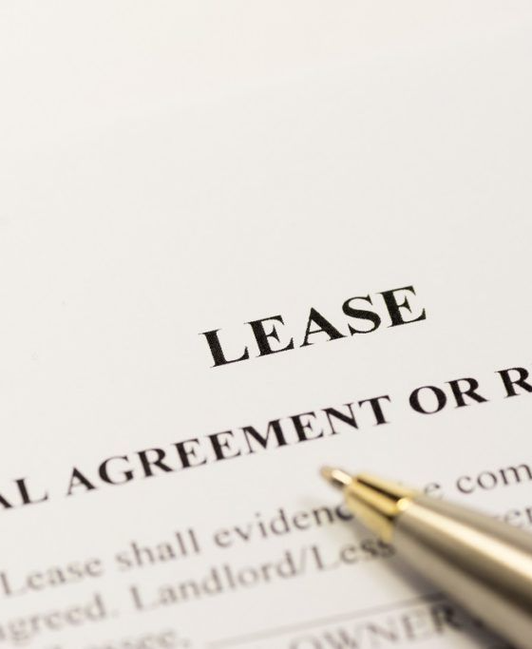
What is a Lease?
Legally, a lease is a document creating an interest in land for a fixed period of time and usually in consideration of the payment of rent. In strictly legal terms it has been defined as a contract for the exclusive possession and profit of land for some determinate time. A lease, therefore, creates for a term of years, a leasehold relationship between a landlord (or lessor) and tenant (or lessee).

Slide 33
Essential Elements of a Valid Lease
OCCUPIER OR LESSEE
EXCLUSIVE POSSESSION
PERIOD OF LEASE
Refers to the person who resides in the leased premises.
The lessee must have an interest that entitles him to exclude all other persons, including the lessor from the premises.
The Land Act, 2012 permits an owner to lease land or part of it to any person for a definite term.
CONSIDERATION
LAND AND PARTIES
The considerations are either premium or rent paid in exchange for the lease.
The land, part thereof, and parties must be clearly defined or identified.

Slide 34
Distinctions Between a Lease and a License
Most lessors wonder if leases and licenses are substitutable. The answer is no.
With a lease, there is an exclusive possession of land by the lessee unlike with licenses. A license amounts to the creation of personal rights between the parties concerned.
Licenses are mere permissions to stay on the land and cannot be assigned to a third party. They are not protected by law and are easily revocable by the issuance of reasonable notice.
Overall, they confer more rights than licenses such as quiet possession, non-derogation from grant, and repairs. Licenses are however contractual permission to use the premises.
A lease provides exclusive possession of land/Premises

Slide 35
Obligations Implied on a Lessor
QUIET POSSESSION
  To give quiet and peaceful possession to the lessee.
NO DEROGATION
  Not to derogate from the grant/lease given to the lessee
HABITABLE PREMISES
  Ensure the premises are fitting for habitation
FIT FOR PURPOSE
  Ensure the property is fit for the intended purpose
PAY RATES AND TAXES
  Pay all rates, taxes due, and outgoings

Slide 36




Obligations Implied on a Lessee
TIMELY RENT PAYMENT
SUSTAINABLE LAND USE
MAINTAIN PROPERTY CONDITION
REASONABLE PROPERTY REPAIR
To pay rent on time and in the manner specified in the lease agreement
To use the leased land in a sustainable manner and according to lease conditions
To yield up land and buildings in the condition at the start of the lease, excluding normal wear and tear
To keep all buildings in a reasonable state of repair

Slide 37


Types of Leases
PERIODIC LEASE
SHORT TERM LEASES
LONG TERM LEASES
The term of this lease is not specified and no provision is made for giving notice to terminate the tenancy.
These are leases of two (2) years or less without an option for renewal.
These are used to grant title to apartment units or maisonettes although this practice will be phased out.

Slide 38
Registration of Leases and Effect of Non-Registration
The provisions governing registration of leases are: -
REGISTRATION OF LEASES OVER 2 YEARS
CONSENT FOR FURTHER DEALINGS
EFFECT OF NON-REGISTRATION
All leases of more than 2 years should be registered.
After registration of a lease that required consent of the lessor before registration, no further dealings will be registered without the same consent of the lessor.
The Land Registration Act, 2012 provides that any unregistered lease instruments shall be construed as mere contracts and not as an interest having passed.

Slide 39

Controlled Tenancies
A controlled tenancy is a type of commercial lease that comes about under the operation of the provisions of the Landlord and Tenant (Shops, Hotels and Catering Establishments) Act, (Cap 301, Laws of Kenya) (the “Act”).
The Act defines a “controlled tenancy” to mean a tenancy of a shop, hotel, or catering establishment which
Has not been reduced to writing
Has been reduced into writing but is for less than 5 years or contains provision for termination, otherwise than for breach of covenant, within five years from the commencement thereof.

Slide 40

Controlled Tenancies
A tenancy is, under the Act, created by a lease, under-lease, agreement to lease, or operation of the law. If your lease is oral or is for less than 5 years or contains a break clause, it is automatically caught by the provisions of the Act. Even a tenancy created by operation of law or a sub-tenancy can be a controlled tenancy. Any agreement seeking to preclude the provisions of the Act in a controlled tenancy is void.
We advise lessors to safeguard their interests by having leases in place that are for more than 5 years with no termination clauses

Slide 41

Class of Premises Exempt from Provisions of the Act
The Act only exempts leases to which the Government or a County Government is a party, whether as landlord or as tenant, from being a controlled tenancy.
The Act covers a wide range of premises which can be subject to controlled tenancy including:
Shops defined as retail or wholesale trade premises or business premises. The definition is wide enough to cover a whole raft of commercial premises.
Catering establishments: These are premises where food or drink is supplied for consumption thereon.
Hotels premises for accommodation or accommodation and meals for up to five or more adult persons.

Slide 42
Disadvantages of Controlled Tenancy?
A controlled tenancy isn’t optimal for landlords/lessors because it contains terms onerous to the landlord and protects tenants/lessees in transactions. Some of the provisions and terms that are unfavorable to lessors/landlords as follows:
TERMINATION PROCESS
RENT ASSESSMENT
Termination or alteration of the terms of the tenancy can only be subject to the Act’s provisions. This requires 2 months’ tenancy notices.
Tenants can apply for rent assessment or review or alteration of the terms of the tenancy and the tribunal has the power to decide how much rent is paid.
TERMINATION GROUNDS
DISTRESS FOR RENT
Termination of the tenancy can only be based on the grounds listed under the Act and such termination can be challenged by reference to the Tribunal
The powers of the Tribunal extend to varying the rent payable, permitting the levy of distress of rent, fixing the amount of service charge payable, among others

Slide 43
Keys Things to Look at Before Entering into a Lease
CONFIRM OWNERSHIP
STRUCTURAL INSPECTION
REVIEW CHARGES
Confirm ownership of the land and check for any encumbrances.
Undertake a structural survey to assess condition of property.
Understand how service charges and rents are billed.
MARKET ANALYSIS
SECURITY DEPOSITS
Seek expert opinion on prevailing market rents.
Ensure security deposits are refunded after lease expiry.

Slide 44

Overview of Land Ownership & Property Rights in Kenya
Since the Constitution of Kenya was promulgated and brought about its law reforms relating to land, Article 260 defines land as:
a) The surface of the earth and the subsurface rock;
b) Any body of water on or under the surface;
c) Marine waters in the territorial sea and exclusive economic zone;
d) Natural resources completely contained on or under the surface; and
e) The airspace above the surface;

Slide 45
Classifications of Land
FREEHOLD LAND
  Land that gives the holder absolute ownership for life and can be succeeded by descendants.
LEASEHOLD LAND
  Land held for a specific time period with payment of a fee/rent. Does not provide absolute ownership.
PUBLIC LAND
  Land held by the government in trust for the people. Includes state land, unclaimed land, minerals, forests, etc.
COMMUNITY LAND
  Land lawfully registered to a community group or transferred to a community.
PRIVATE LAND
  Registered land held under freehold or leasehold tenure.
REAL PROPERTY
  Real Property is fixed permanently to one location.
PERSONAL PROPERTY
  Personal property is movable property

Slide 46
Highlights of the Key Changes to Land Laws in Kenya
REPEAL OF MULTIPLE OLD LAND STATUTES
REPEALING OF EARLIER STATUTES
non-citizens can only hold land for a period of 99 years under a leasehold tenure.
Previously, there were 7 statutes relating to land which were repealed and consolidated into three main statutes
SPOUSAL CONSENT REQUIRED FOR LAND SALES
CONSENT OF SPOUSE REQUIRED FOR DISPOSITION
Spousal consent is required for sales or leases of land by a married person.
where a spouse who holds land or a dwelling house in his/her name individually and undertakes a sale of that land or dwelling house, the purchaser shall be under duty to inquire whether the spouse has consented to the sale.

Slide 47
PROTECTION OF TENANTS UNLAWFULLY EVICTED:
DIFFERENT SYSTEMS OF REGISTRATION OF TITLES
A tenant who is evicted contrary to the terms of his lease is immediately relieved of the obligation to pay rent or other monies due under the lease or from performance of any covenants of the lease.
Under the old land law, title deeds were issued under one of the following statutes, which have now been repealed: The Registered Land Act (RLA); The Registration of Titles Act (RTA); The Land Titles Act (LTA); and The Government Lands Act (GLA).
NON-EVICTION OF A PURCHASER IN POSSESSION
FORMATION OF AN ENVIRONMENT AND LAND COURT
Under the new law, when a purchaser takes possession of land prior to completion of the sale, the vendor can only regain possession peaceably (no resistance from purchaser) or through a court order
The Environment and Land Court will have jurisdiction to hear and determine disputes related to land.

Slide 48


